Slide 1
Agile Software Development
By
Dr. Junaid Akram
Assistant Professor, Department of Computer Science COMSATS (Lahore)

Slide 2
Agile Software Development
We will cover…
What is it?
Who does it?
Why is it important?
What are the steps?
What is the work product?
How do we ensure that we have done it right?

Slide 3
The Manifesto for Agile Software Development
“We are uncovering better ways of developing software by doing it and helping others do it. Through this work we have come to value:
Individuals and interactions over processes and tools
Working software over comprehensive documentation
Customer collaboration over contract negotiation
Responding to change over following a plan

Slide 4
What is Agility?
Effective (rapid and adaptive) response to change
Effective communication among all stakeholders
Drawing the customer onto the team
Organizing a team so that it is in control of the work performed
Yielding …
Rapid, incremental delivery of software

Slide 5
An Agile Process
Is driven by customer descriptions of what is required (scenarios)
Recognizes that plans are short-lived
Develops software iteratively with a heavy emphasis on construction activities
Delivers multiple ‘software increments’
Adapts as changes occur
limiting documentation

Slide 6
Agility Principles
Our highest priority is to satisfy the customer through early and continuous delivery of valuable software.
Welcome changing requirements, even late in development.
Deliver working software frequently, from a couple of weeks to a couple of months, with a preference to the shorter timescale.
Business people and developers must work together daily throughout the project.
Build projects around motivated individuals. Give them the environment and support they need, and trust them to get the job done.
The most efficient and effective method of conveying information -- face-to-face conversation.
Working software is the primary measure of progress.
Agile processes promote sustainable development.
Continuous attention to technical excellence and good design enhances agility.
Simplicity—the art of maximizing the amount of work not done—is essential.
The best architectures, requirements, and designs emerge from self–organizing teams.
At regular intervals, the team reflects on how to become more effective

Slide 7
Extreme Programming (XP)
The most widely used agile process, originally proposed by Kent Beck
XP Planning
Begins with the creation of “user stories”
Agile team assesses each story and assigns a cost
Stories are grouped to for a deliverable increment
A commitment is made on delivery date
After the first increment “project velocity” is used to help define subsequent delivery dates for other increments

Slide 8
Extreme Programming (XP)
XP Design
Encourage the use of CRC cards (Class Responsibility Collaborator).. see Chapter 8
For difficult design problems, suggests the creation of “spike solutions”—a design prototype
Encourages “refactoring”—an iterative refinement of the internal program design
XP Coding
Recommends the construction of a unit test for a store before coding commences
Encourages “pair programming”
XP Testing
All unit tests are executed daily
“Acceptance tests” are defined by the customer and executed to assess customer visible functionality

Slide 9
Extreme Programming Core Practices (A)
Principle or practice | Description
Incremental planning | Requirements are recorded on story cards The developers break these stories into development ‘Tasks’.
Small releases | The minimal useful set of functionality that provides business value is developed first. Releases of the system are frequent and incrementally add functionality to the first release.
Simple design | Enough design is carried out to meet the current requirements and no more.
Test-first development | An automated unit test framework is used to write tests for a new piece of functionality before that functionality itself is implemented.
Refactoring | All developers are expected to refactor / restructure the code continuously as soon as possible code improvements are found. This keeps the code simple and maintainable.

Slide 10
Extreme Programming Core Practices (B)
Pair programming | Developers work in pairs, checking each other’s work and providing the support to always do a good job.
Collective ownership | The pairs of developers work on all areas of the system, all the developers take responsibility for all of the code. Anyone can change anything.
Continuous integration | As soon as the work on a task is complete, it is integrated into the whole system. After any such integration, all the unit tests in the system must pass.
Sustainable pace | Large amounts of overtime are not considered acceptable as the net effect is often to reduce code quality and productivity
On-site customer | A representative of the end-user of the system (the customer) should be available full time. In an extreme programming process, the customer is a member of the development team and is responsible for bringing system requirements to the team for implementation.

Slide 11

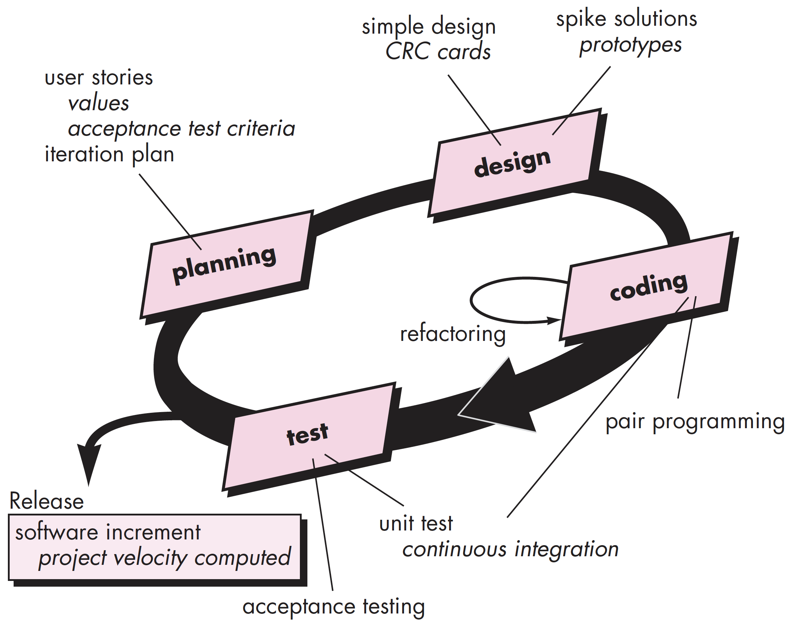



Extreme Programming (XP) Release Cycle

Slide 12
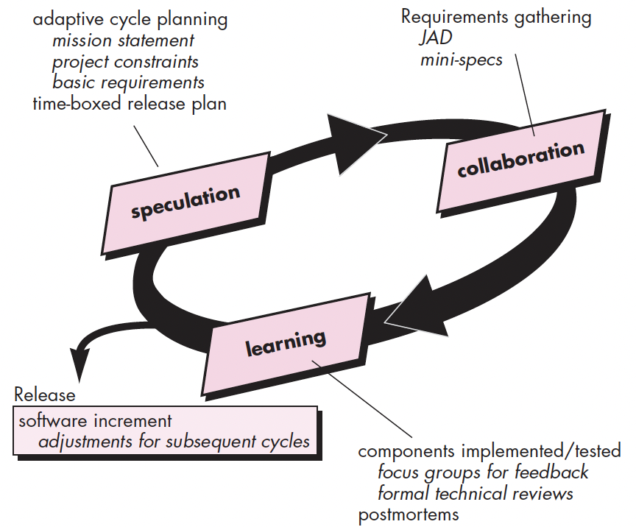
Adaptive Software Development
*JAD (Joint Application Development)

Slide 13
Adaptive Software Development
Originally proposed by Jim Highsmith
ASD — distinguishing features
Mission-driven planning
Component-based focus
Uses “time-boxing” (See Chapter 24)
Explicit consideration of risks
Emphasizes collaboration for requirements gathering
Emphasizes “learning” throughout the process

Slide 14
Scrum
Originally proposed by Beedle
Scrum—distinguishing features
Development work is partitioned into “packets”
Testing and documentation are on-going as the product is constructed
Work occurs in “sprints” and is derived from a “backlog” of existing requirements
Meetings are very short and sometimes conducted without chairs
“demos” are delivered to the customer with the time-box allocated

Slide 15
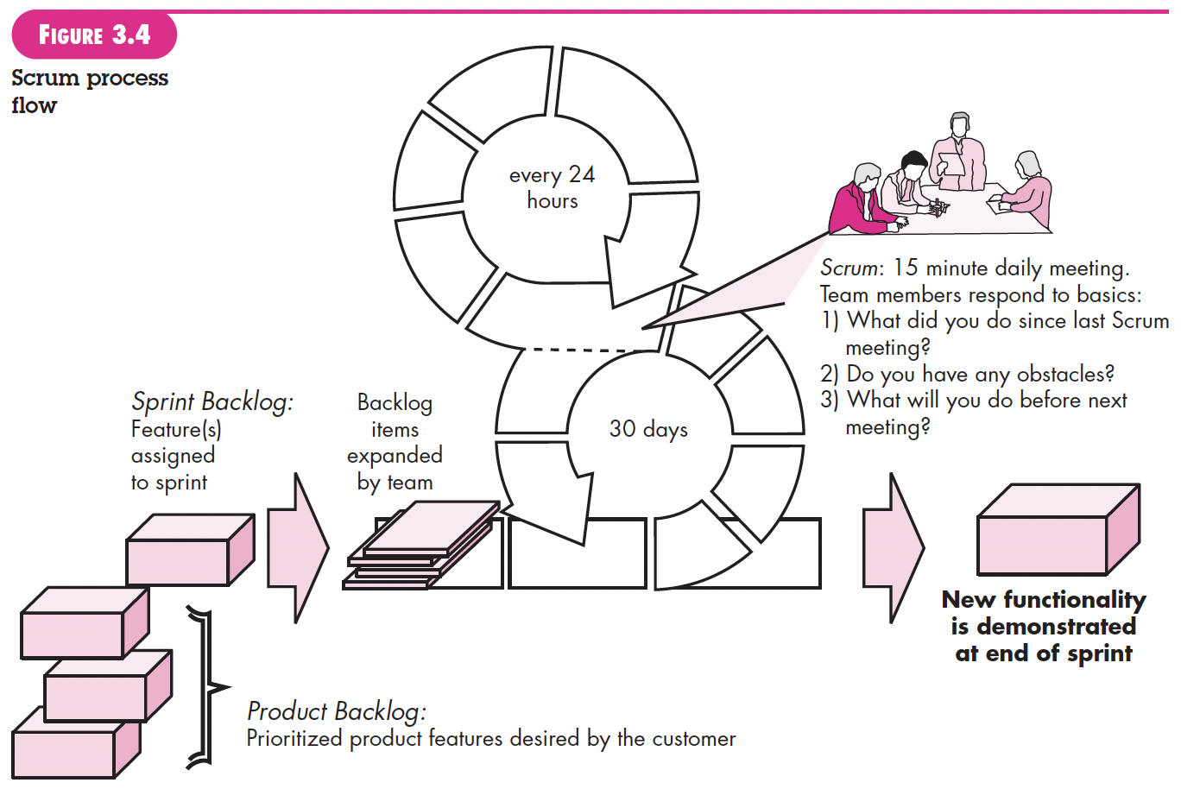
Scrum

Slide 16
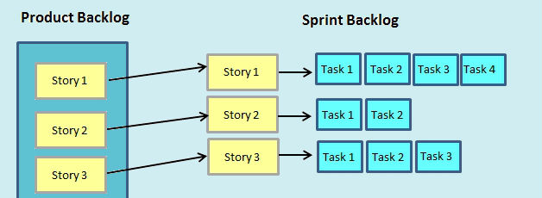
AGILE, PRODUCT MANAGEMENT
Agile is a very useful project management methodology when used right.
Unfortunately, if the whole team is not familiar with it, things can become inefficient.
To avoid that, all agile team members must know what a product backlog and sprint backlog are, both of which are essential for planning and prioritizing tasks in agile project management.
These concepts also apply to scrum, kanban and other similar agile frameworks.

Slide 17
What Is a Product Backlog?
The product backlog is a list that compiles all the tasks and user stories that must be done to complete the whole project.
An effective product backlog breaks down each of the backlog items into a series of steps that help the development team.
Agile teams constantly update their product backlogs to respond to changes
It consists in adding, deleting and prioritizing tasks in the agile product backlog
This is done during an agile event called product backlog grooming meeting
This product backlog shows project tasks and user stories, as well as their deadline, who’s assigned to complete them, their priority level and percent complete.
Managers can easily drag and drop these tasks to refine the product backlog.
It’s always a good idea to prioritize the tasks on your product backlog

Slide 18
What is a Sprint Backlog?
The sprint backlog is a subset of the product backlog.
The sprint backlog comes from the product backlog, but it contains only the product backlog items that can be completed during each agile sprint.
The complexity of the project will determine the sprint backlog
we dedicate the team only to those tasks that can be completed during the sprint.
Unlike the product backlog, the sprint backlog is unchanged during the period of the sprint.
It can be changed, but only during the sprint planning meeting.
Once agreed upon, the items and steps to complete them are frozen for the length of the sprint.

Slide 19
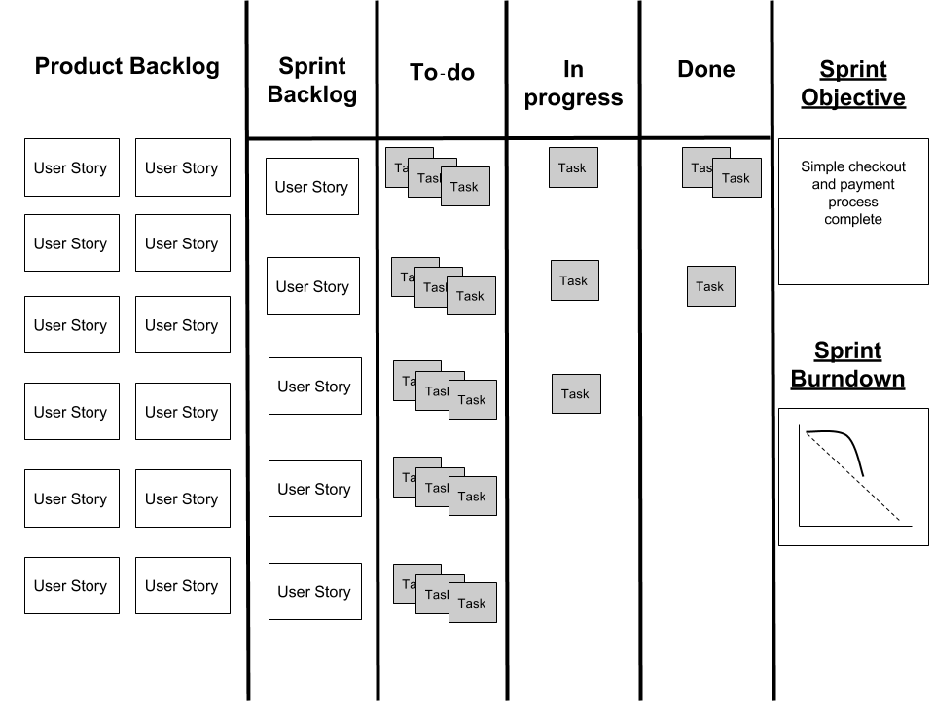

Slide 20
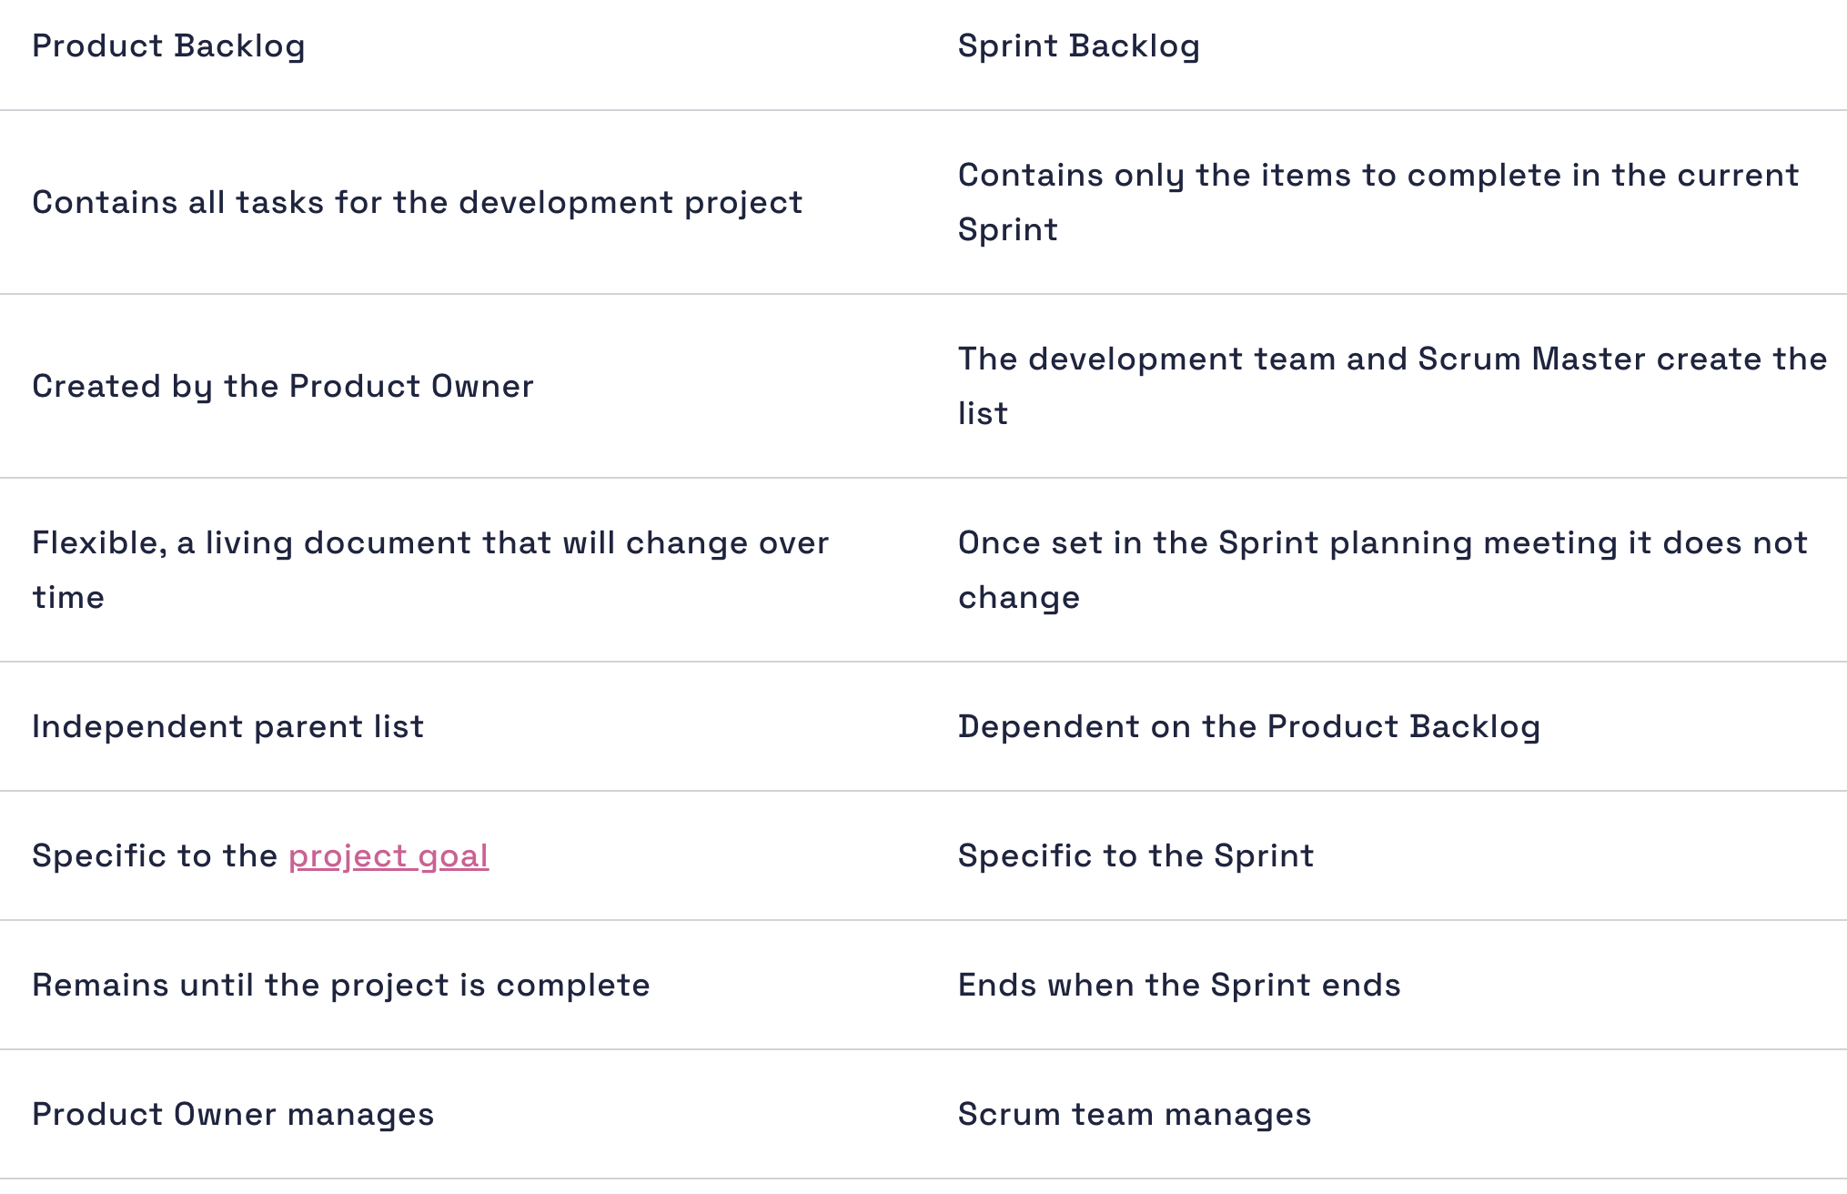

Slide 21
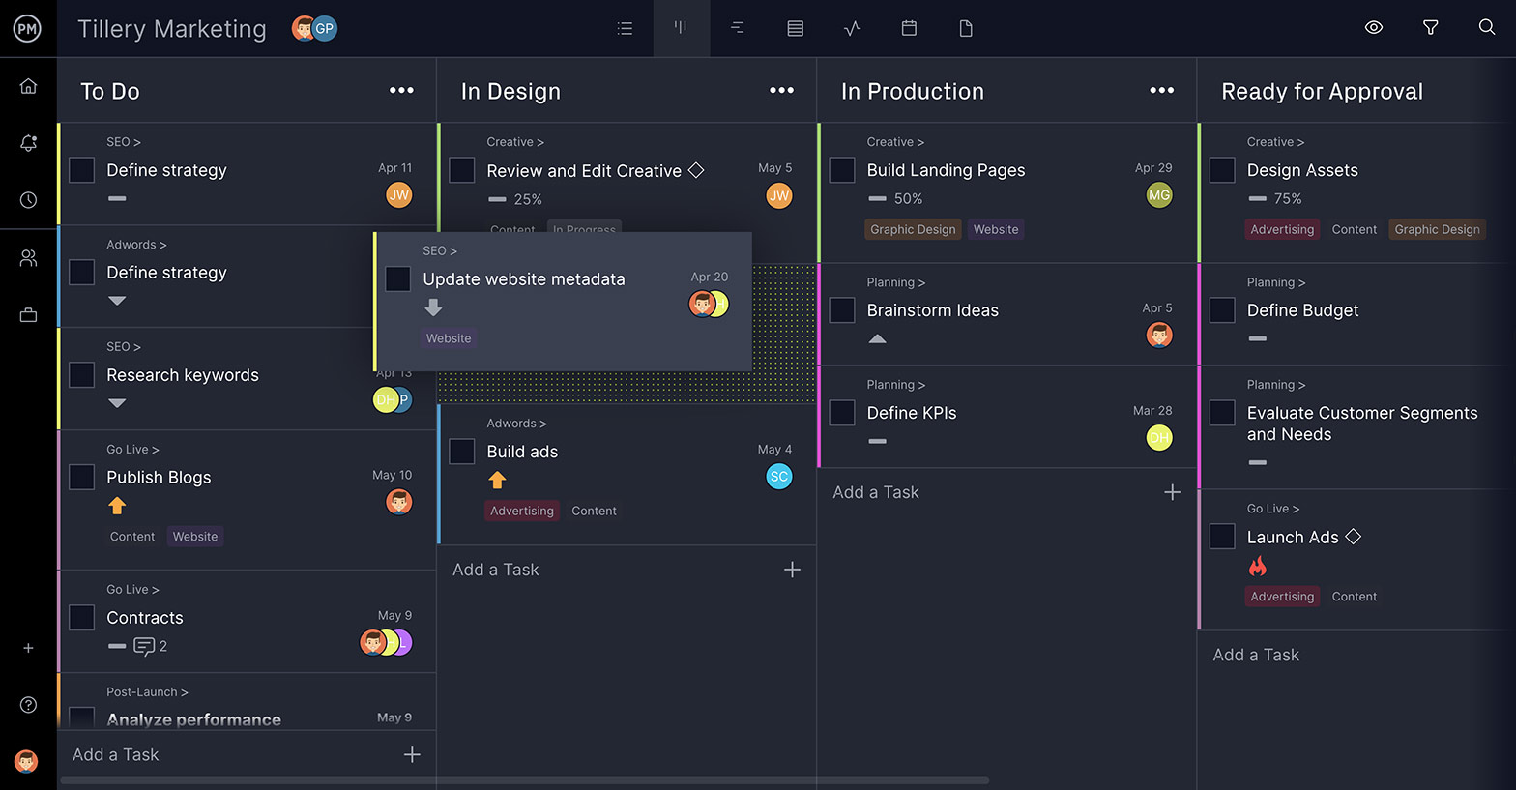
Track Progress on Dashboards

Slide 22
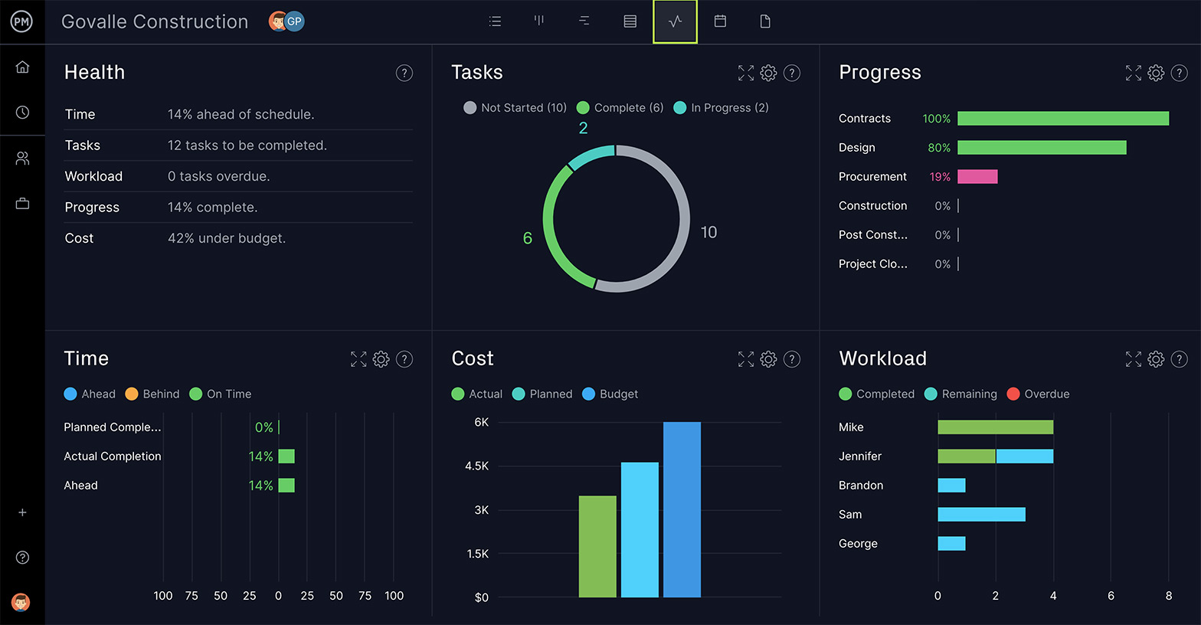
Generate Reports With One Click

Slide 23

Thanks for your attention!
Any Question?
Email me on : junaidakram@cuilahore.edu.pk

